Slide 1
Data Analyses: Pursuit-Tracking Task & Pursuit-Occlusion Task Emulation Pilot Study 2021
Adriana Böttcher, 27.10.22

Slide 2
Sample & Preprocessing

Slide 3
Sample
Initial sample: 34 healthy adults, 4 excluded due to incomplete data recording
→ N = 30
25.42 ± 3.04 years
11 male, 19 female
All participants right-handed

Slide 4
Preprocessing
FPz as reference electrode
Downsampling to 250 Hz
Highpass filter for 1 Hz
Remove line noise at 50 Hz
Remove bad channels (flat, minimum channel correlation)
Lowpass filter 40 Hz
Interpolate bad channels
Rereference to average
Merge data for task A & B: for ICA, epoch data, detrending, artifact rejection
run ICA (extended infomax algorithm)
Iclabel: keep only those Ics that are labelled as neural component with at least 0.5 probability
Visual checks of remaining components
Parallelize behavioral and EEG data → add triggers etc.
Epoch data: 1) for whole trial (-1 13) → baseline correction for fixcross interval (-750 0)
2) -1 4 for task A and B, later reduced to relevant time interval
Artifact rejection for segments

Slide 5
Wavelet analysis & Cluster-based permutation test

Slide 6
Wavelet analysis & CBPT
Morlet wavelet: 5 cycles, length of wavelet kernel = 3 (same for all frequencies)
No ERS/ERD
Frequencies: 1 to 35 Hz
CBPT:
Monte-Carlo, 1000 iterations
Alpha = 0.001, cluster alpha = 0.001
For alpha (8-12 Hz), theta (4-7 Hz) and beta band (13-30 Hz)
Task A: first random vs. constant vs. second random traj segment
averaged only in frequency dimension
Split for interval before and after 500 ms due to high error in first 500 ms of rand1
Rand1: exclude first 500 ms; others: exclude last 500 ms
Task B: averaged in time and frequency dimension

Slide 7
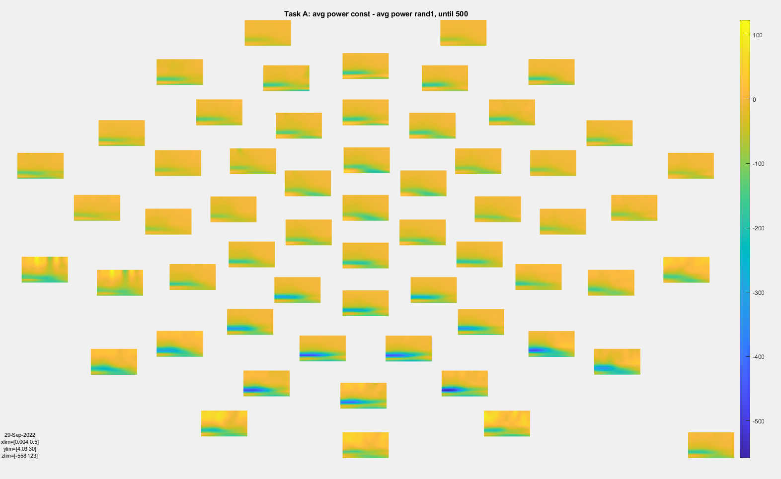
Wavelet analysis- Task A, const-rand1, 0-500 ms

Slide 8
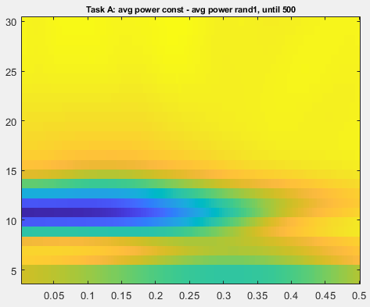
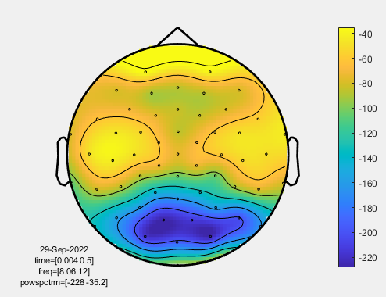
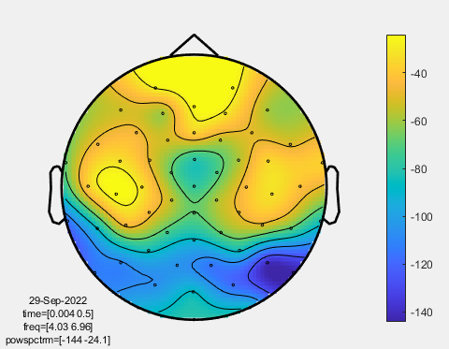
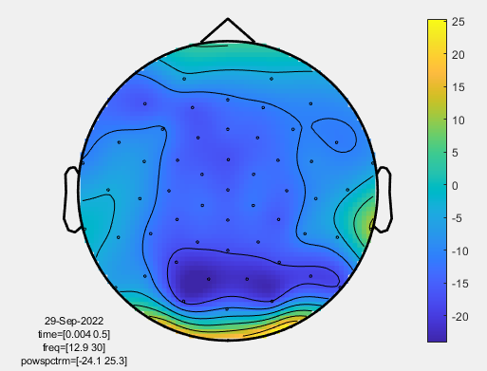
Wavelet analysis- Task A, const-rand1, 0-500 ms
alpha
theta
beta

Slide 9
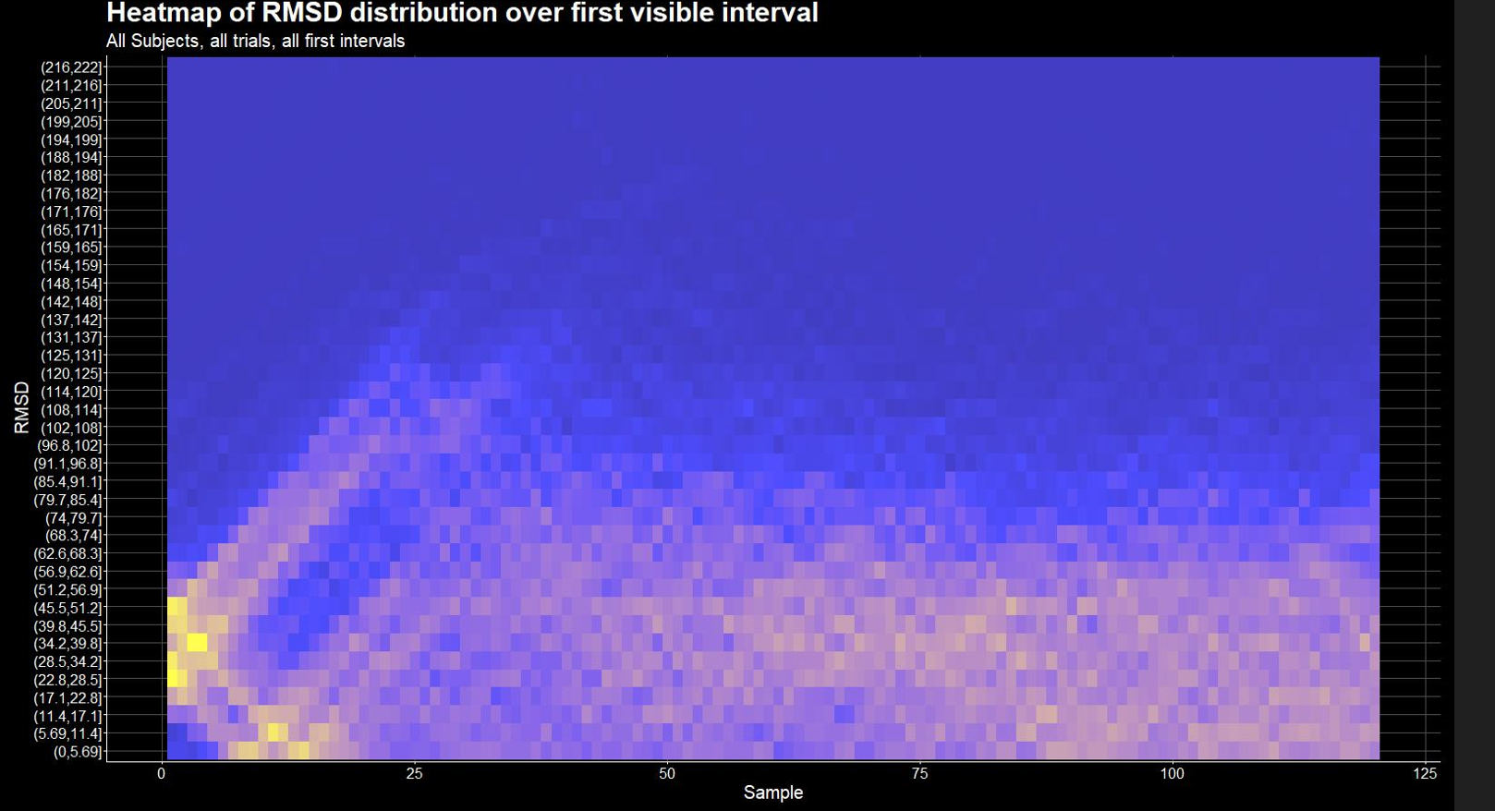
60 samples/frames = 1 s

Slide 10
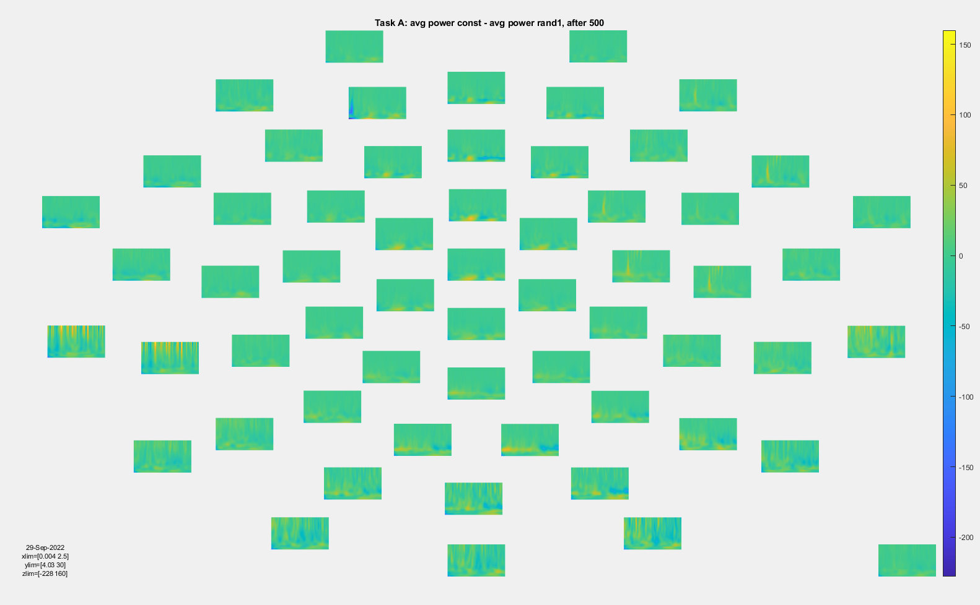
Wavelet analysis- Task A, const-rand1, after 500 ms

Slide 11
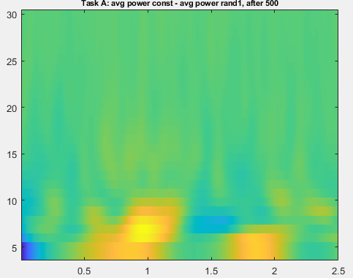
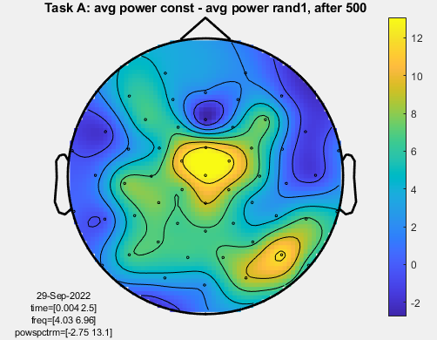
Wavelet analysis- Task A, const-rand1, after 500 ms
theta

Slide 12
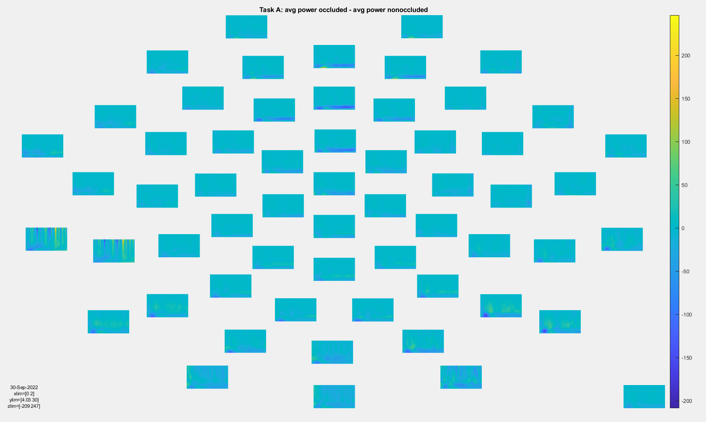
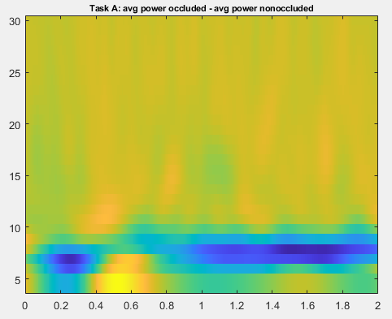
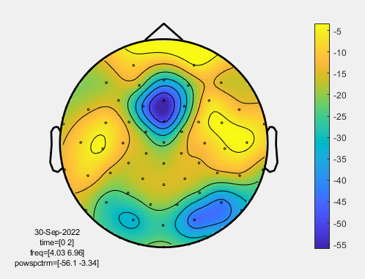
Wavelet analysis- Task B, occluded-nonoccluded
theta

Slide 13
Results CBPT- const vs. rand1 trajectory
 | Until_500 (first 500 ms of const and rand1) | After_500 (500-3000 ms for rand1 vs. 0-2500 ms for const)
Alpha band (8-12 Hz) | 1 sig. neg. cluster (0-500 ms) | No sig. cluster
Beta band (13-30 Hz) | 9 sig. neg. clusters (0-436 ms) | No sig. cluster
Theta band (4-8 Hz) | 3 sig. neg. clusters (68-500 ms) | 2 sig. pos. clusters (928-1944 ms (in time range of rand1))
Const vs. rand1
neg: rand1 > const;
pos: const > rand1

Slide 14
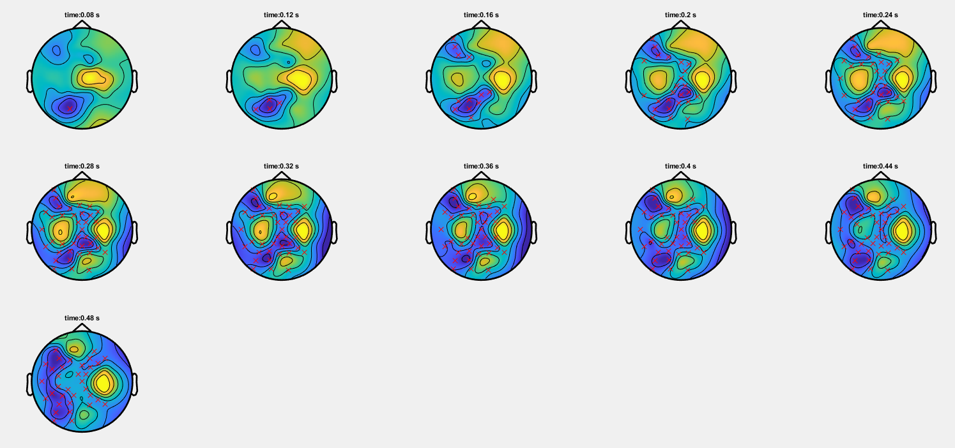
Const vs. rand1, theta, until_500

Slide 15
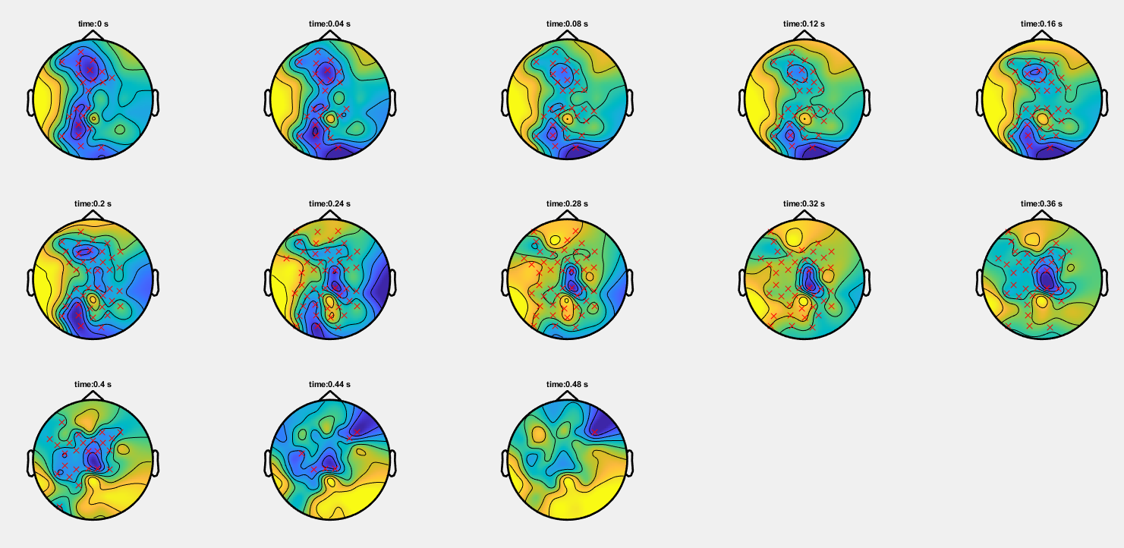
Const vs. rand1, alpha, until_500

Slide 16
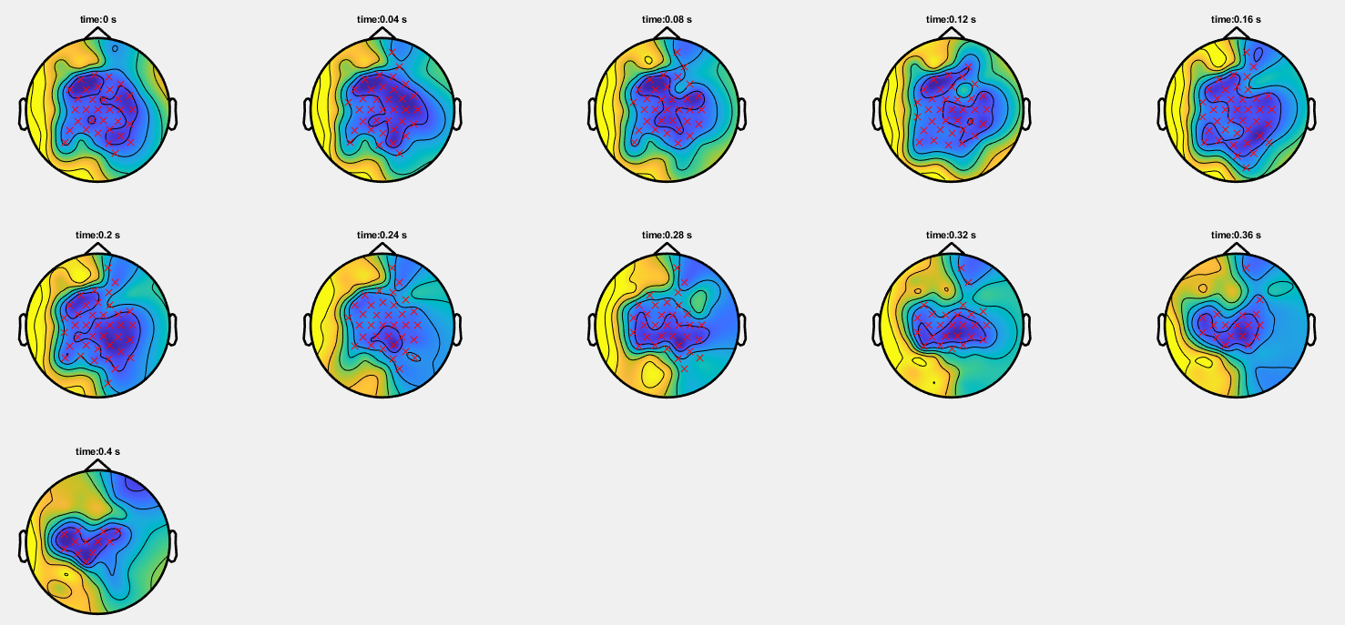
Const vs. rand1, beta, until_500

Slide 17
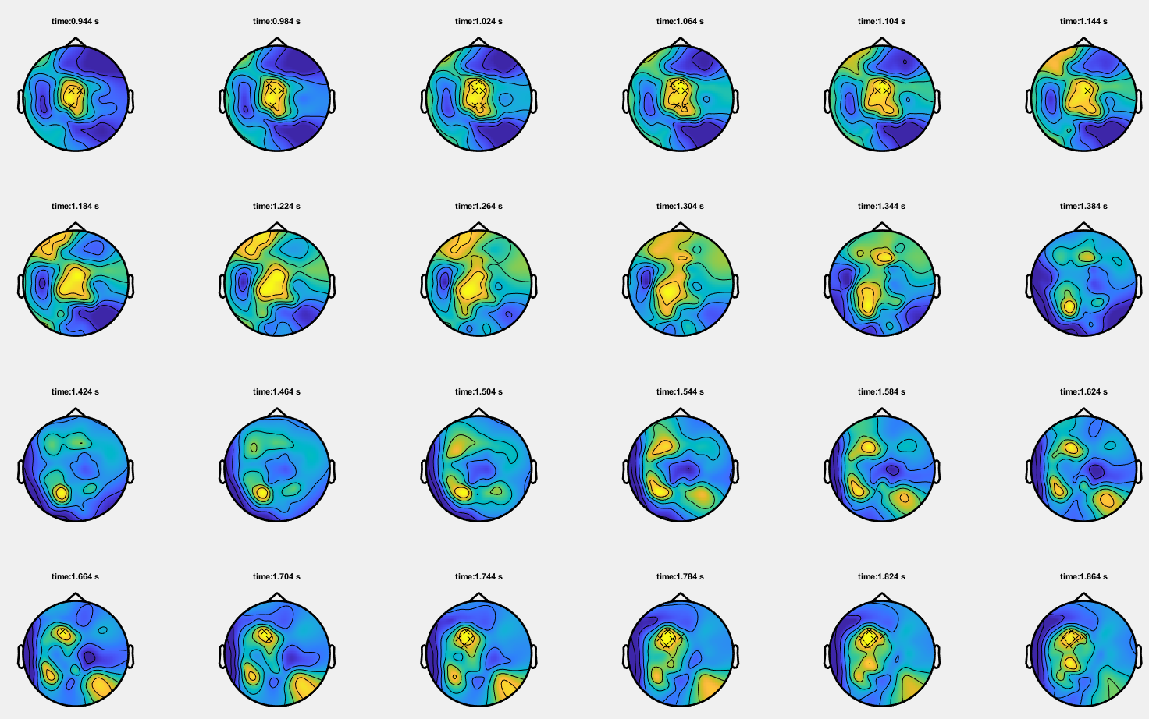
Const vs. rand1, theta, after_500

Slide 18
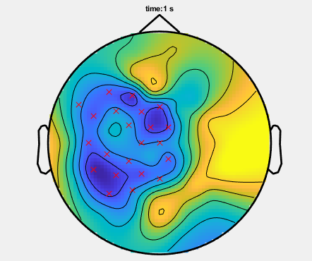
Results CBPT- occluded vs. visible trajectory
 | Occlusion vs. non-occlusion (avg. over time and freq)
Alpha band (8-12 Hz) | No sig. cluster
Beta band (13-30 Hz) | No sig. cluster
Theta band (4-8 Hz) | 1 sig. neg. cluster
Occl. vs. visible
neg: visible > occluded
Significant electrodes (theta)
→ Averaged over time interval

Slide 19
DICS beamforming

Slide 20
DICS Beamforming
Reduce trials to significant time windows
Calculate cross-spectral density matrix for each frequency band and each condition
Cross-spectral density matrix for appended data (both conditions)
Common spatial filter with DICS beamformer (dynamic imaging of coherent sources, Gross et al. 2001)
Apply common filter to both conditions
Calculate ratio: (cond1 - cond2)/(cond1+cond2)
Grand average of ratio across subjects
Interpolate data for MRI and plot

Slide 21
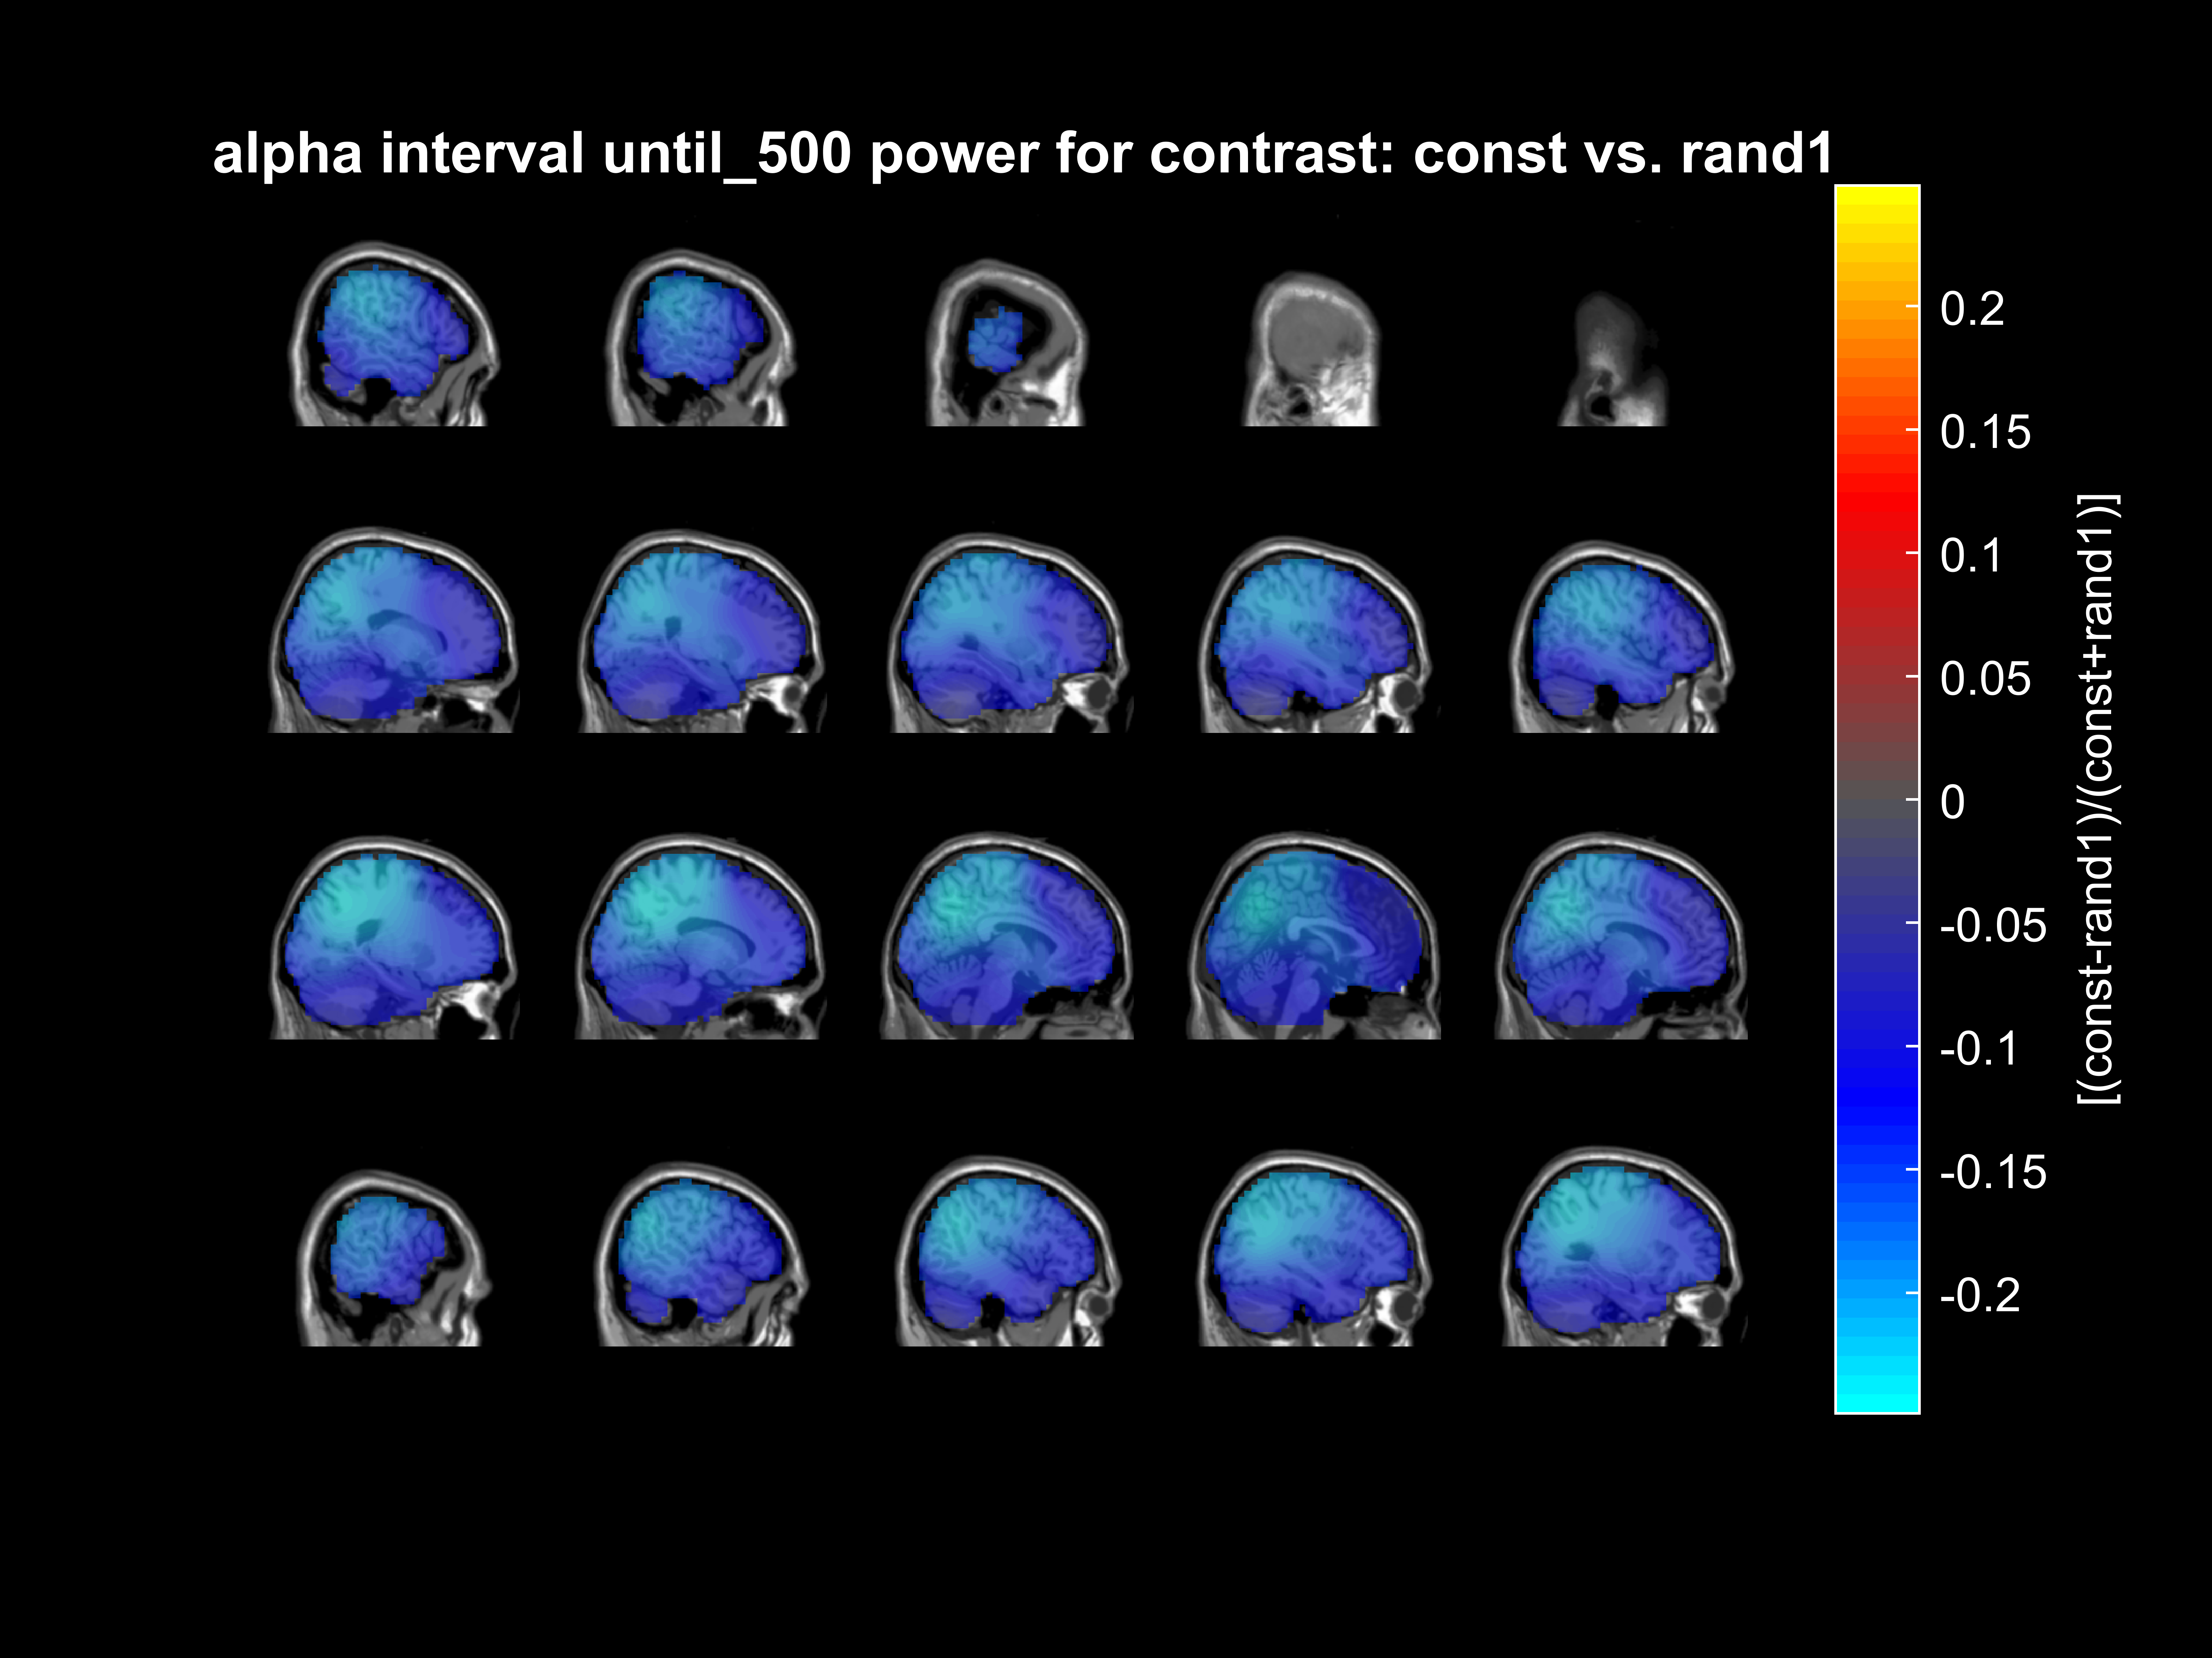
DICS- alpha, const/rand1, until_500
Negative:
Rand1 > const

Slide 22
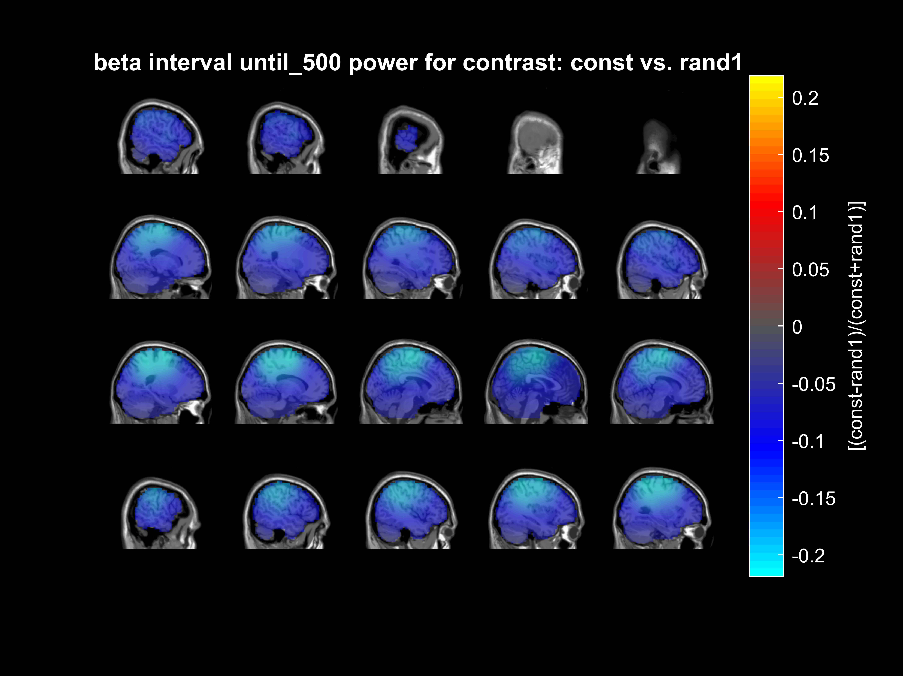
DICS- beta, const/rand1, until_500
Negative:
Rand1 > const

Slide 23

DICS- theta, const/rand1, until_500
Negative:
Rand1 > const

Slide 24
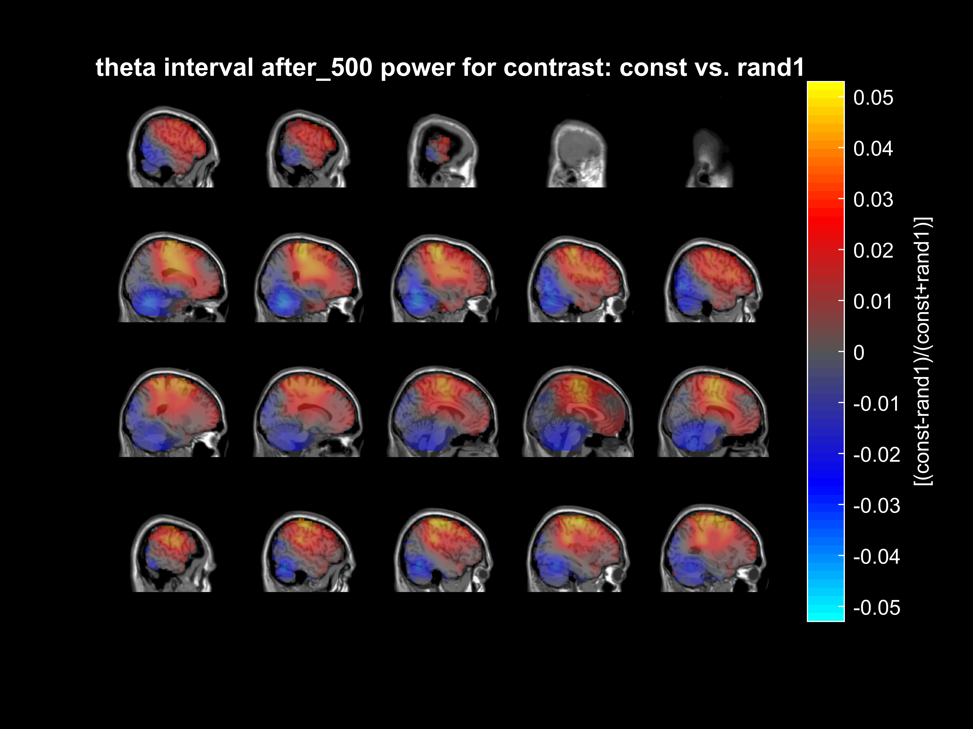
DICS- theta, const/rand1, after_500
Positive:
Const > rand1

Slide 25
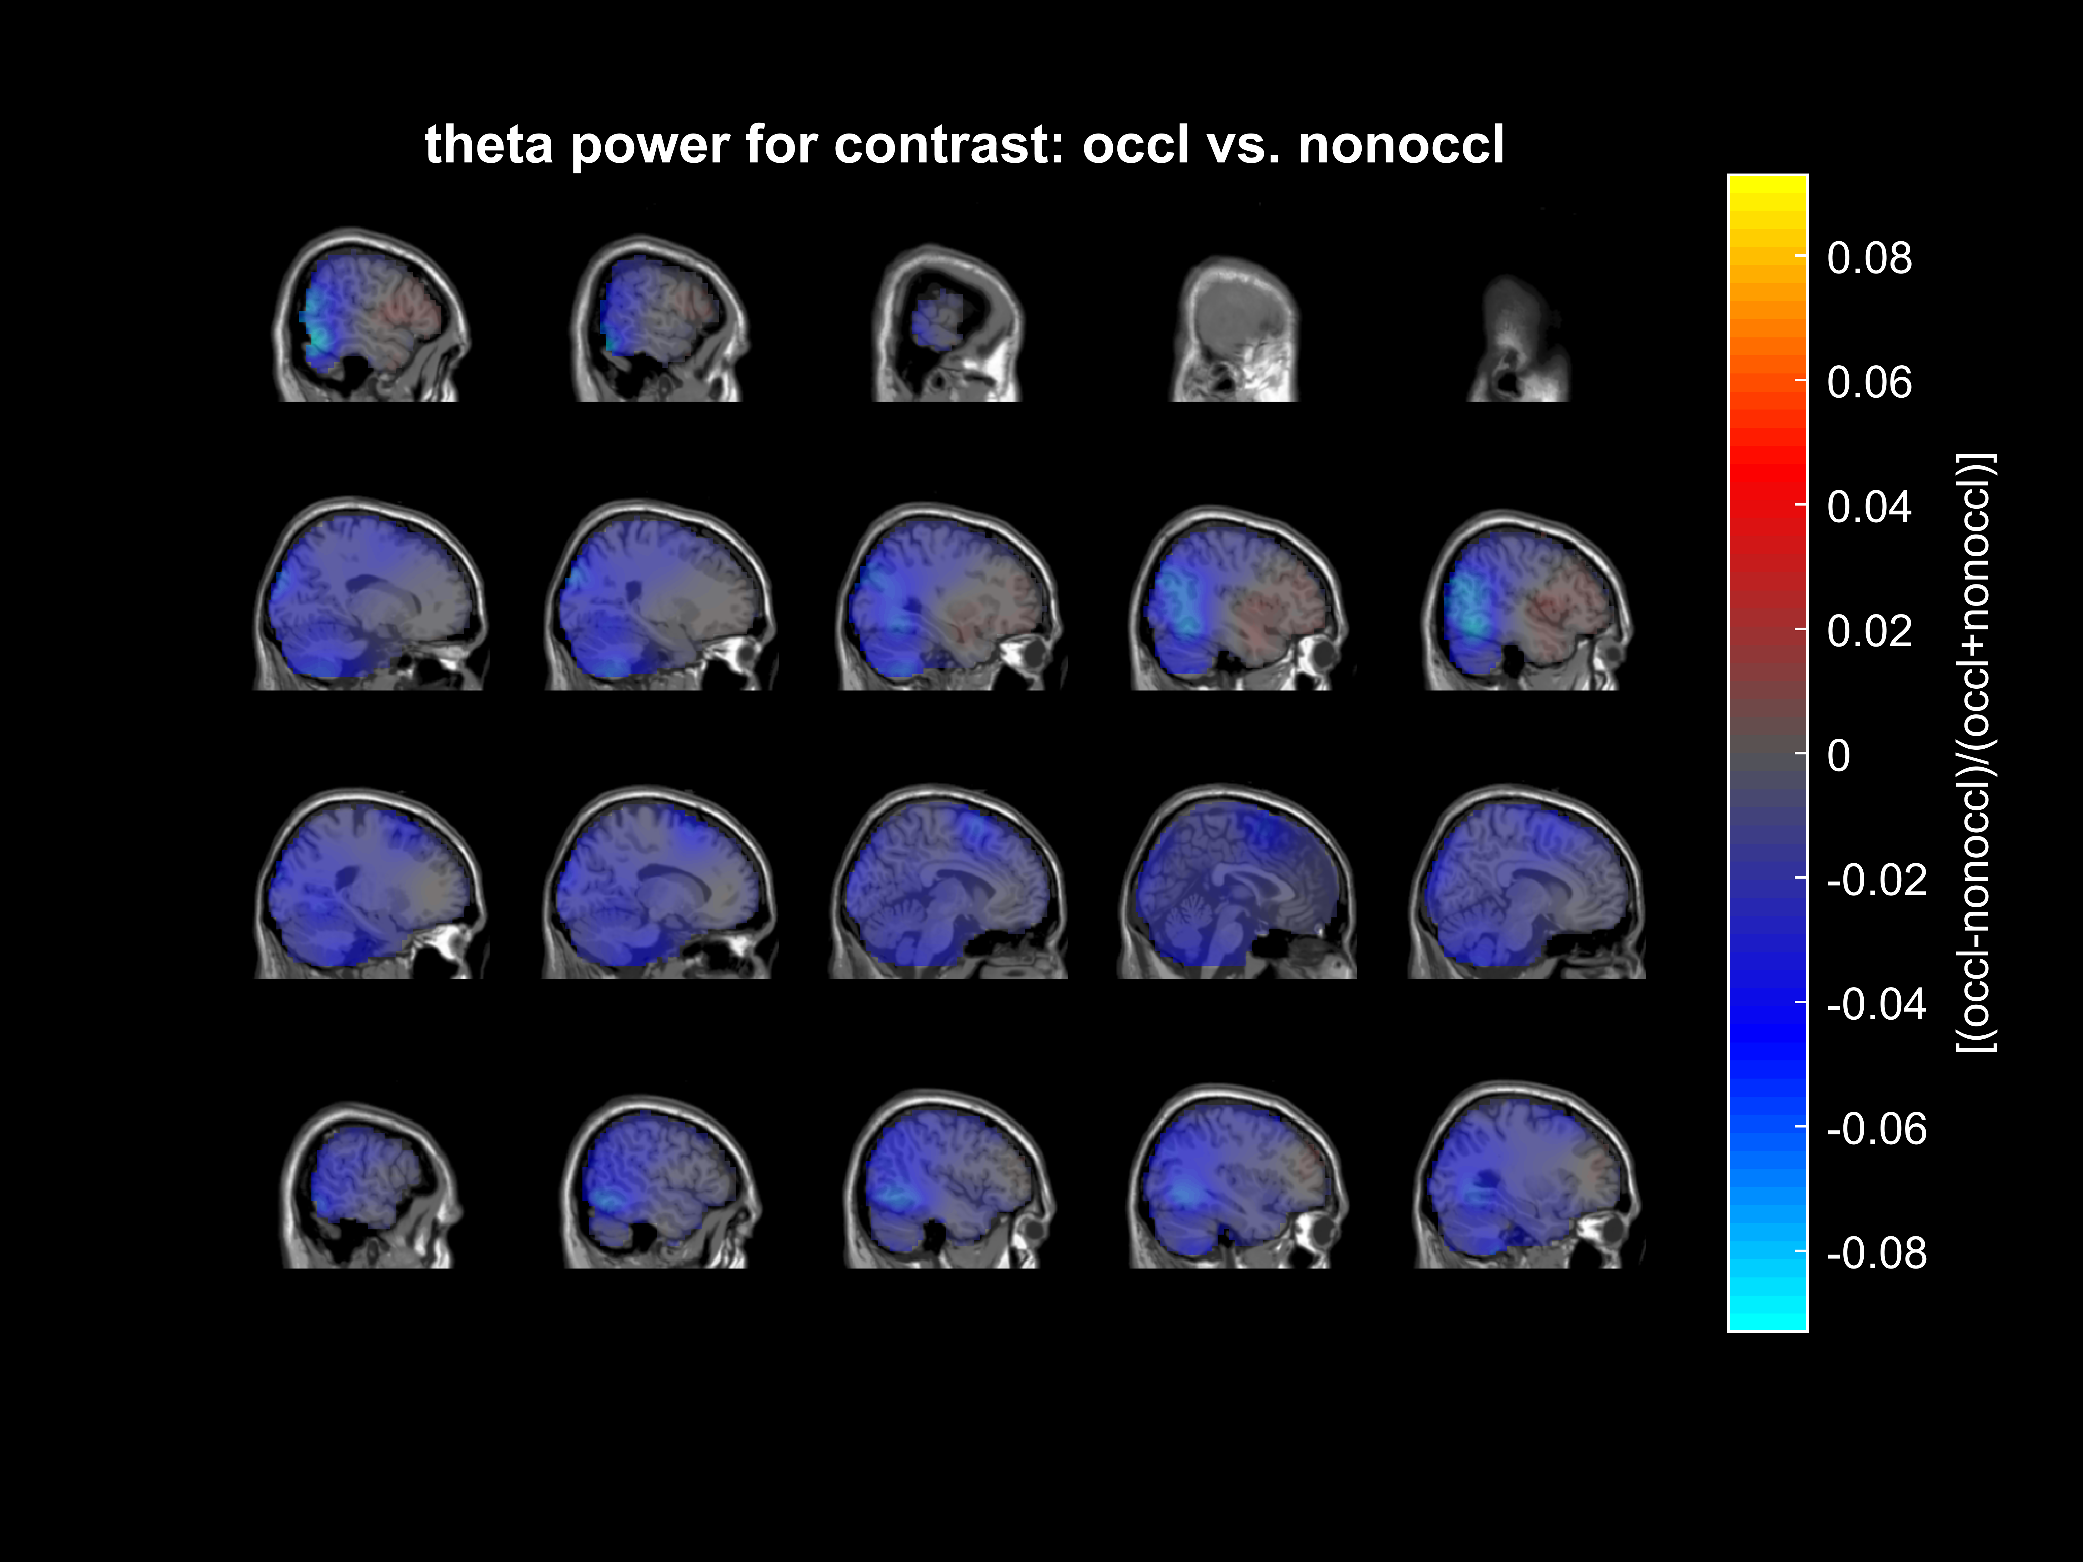
DICS- theta, occluded vs. non-occluded
Negative:
visible > occluded

Slide 26
Thresholding & DBSCAN

Slide 27
Thresholding & DBSCAN
Thresholding: only 1% most positive/negative voxels are included (depending on direction of sig. contrast)
Automatic anatomical labeling (AAL) atlas (Tzourio-Mazoyer et al. 2002) interpolated on data:
Excluded all non-labelled voxels & voxels labelled as cerebellum
Apply DBSCAN (‚density-based spatial clustering of applications with noise‘, Ester et al. 1996)
Epsilon (neighbourhood search radius) = grid_size (0.5 cm)
Update 17/10/22: epsilon changed to 1.5*grid_size to also target voxels connected edge-by-edge, but not corner-by-corner (which would be the case for epsilon = 2*gridsize)

Slide 28
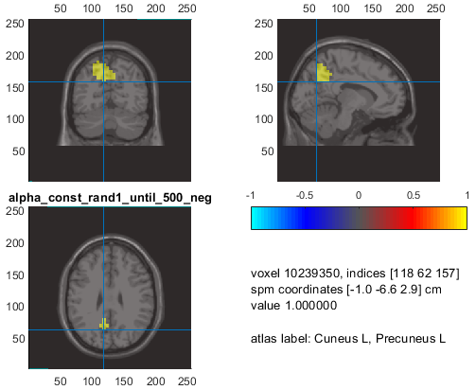
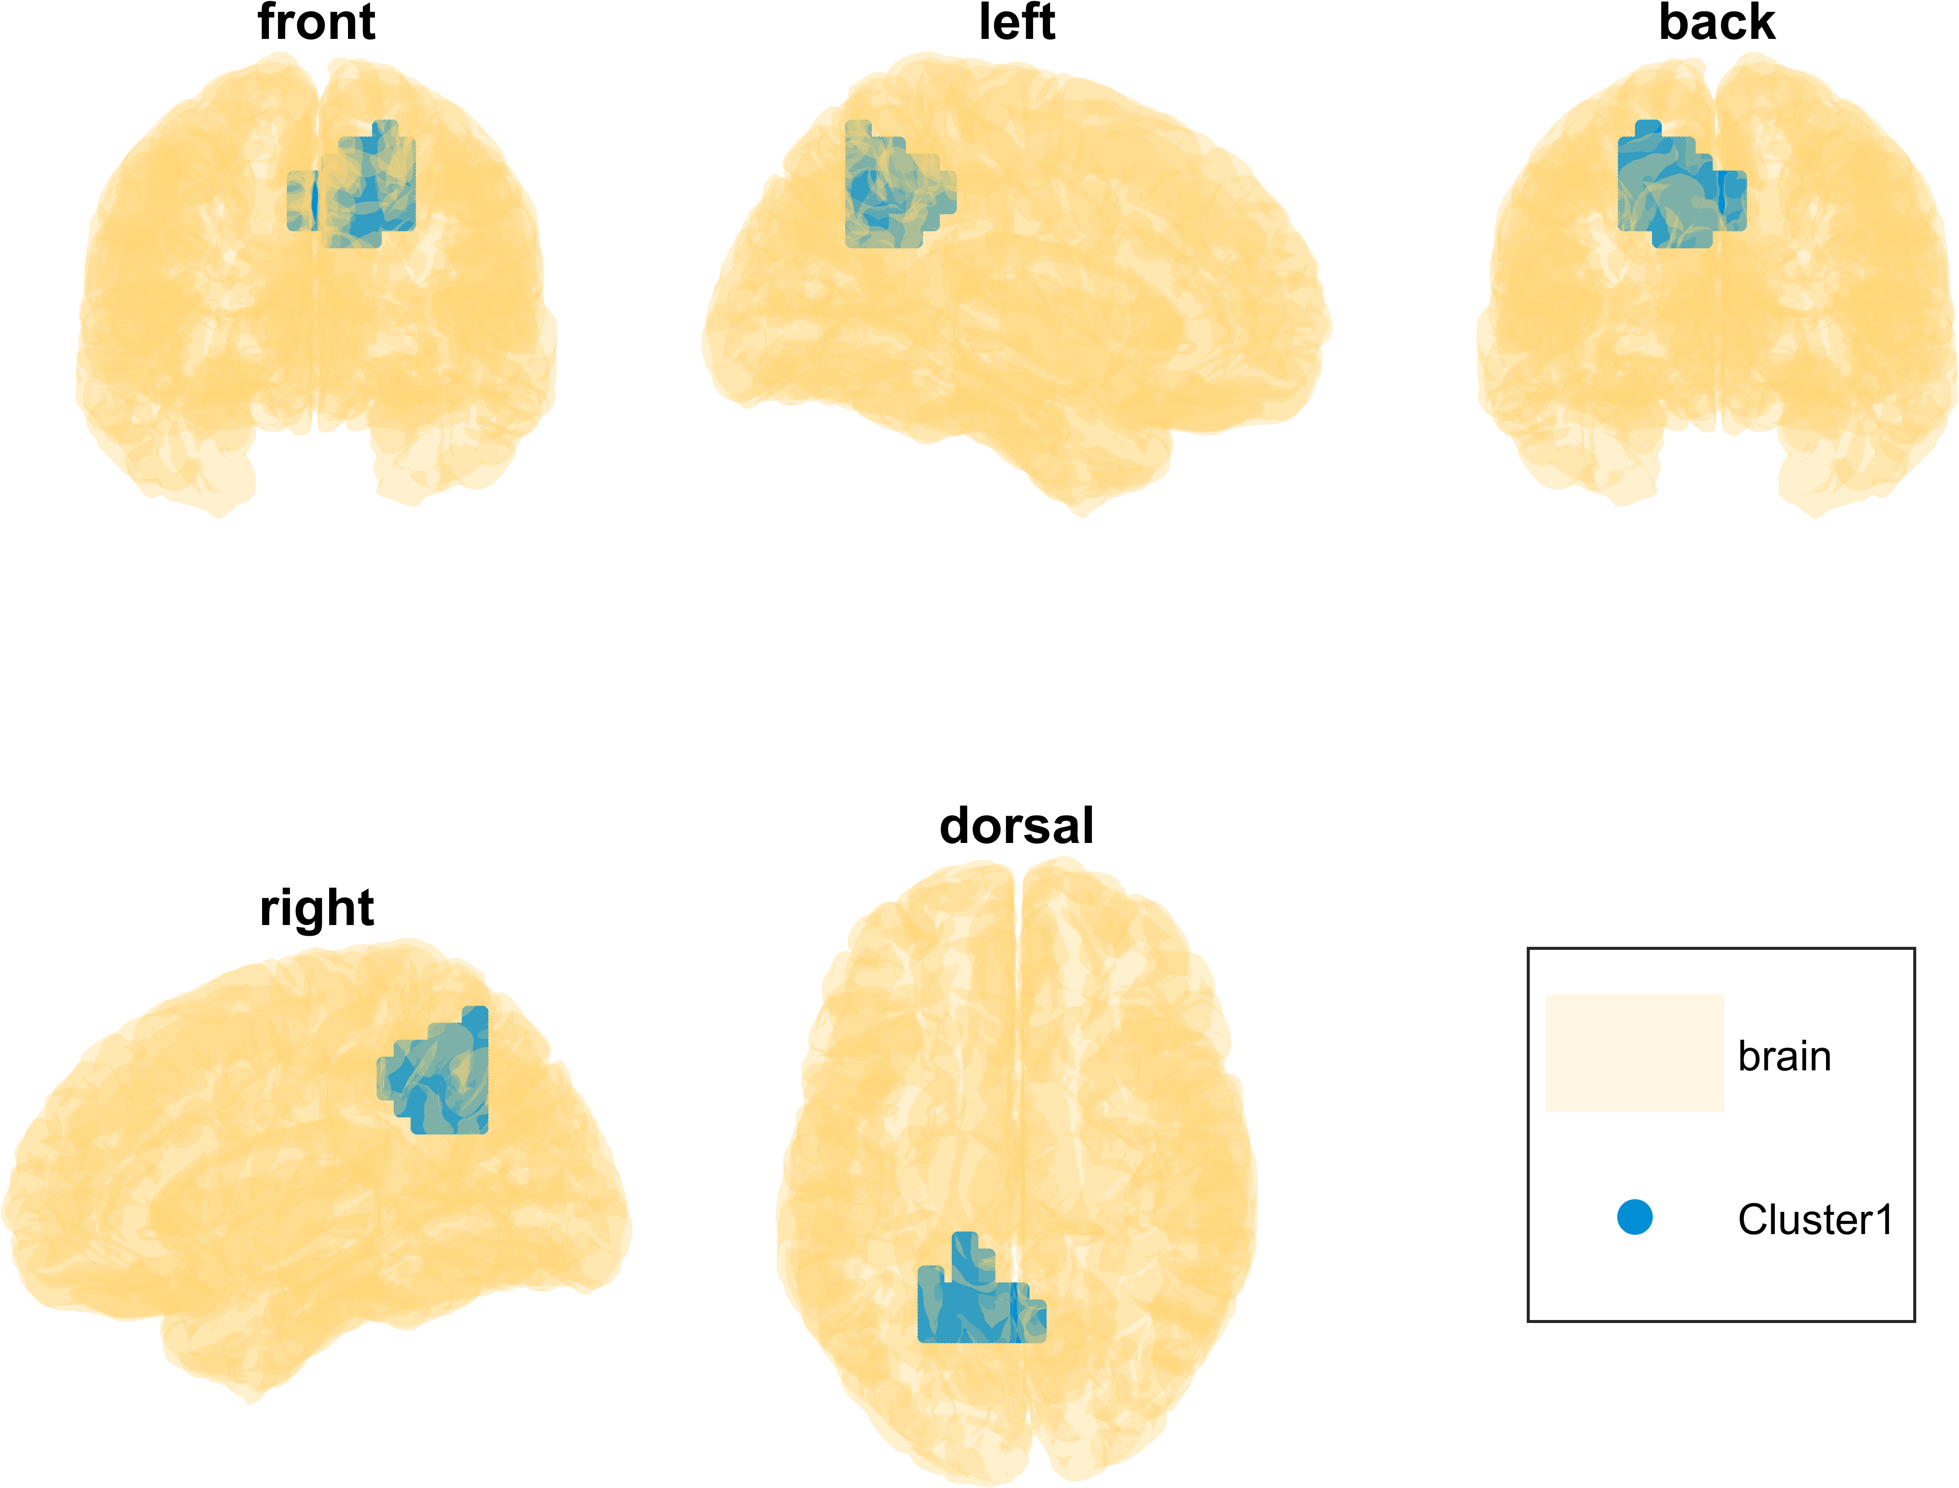
DBSCAN- alpha, const/rand1, until_500 (neg)
27/10/22:Updated results with epsilon = 1.5*gridsize
Nothing changed here
Cluster 1 (& number of voxels per area):
058: Precuneus_L
023: Parietal_Sup_L
005: Cingulum_Mid_L
005: Occipital_Mid_L
005: Precuneus_R
001: Cingulum_Post_L
001: Occipital_Sup_L
Negative cluster:
Rand1 > const

Slide 29
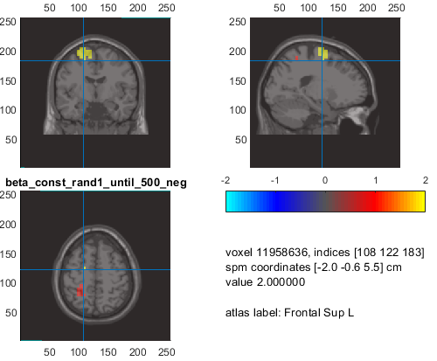
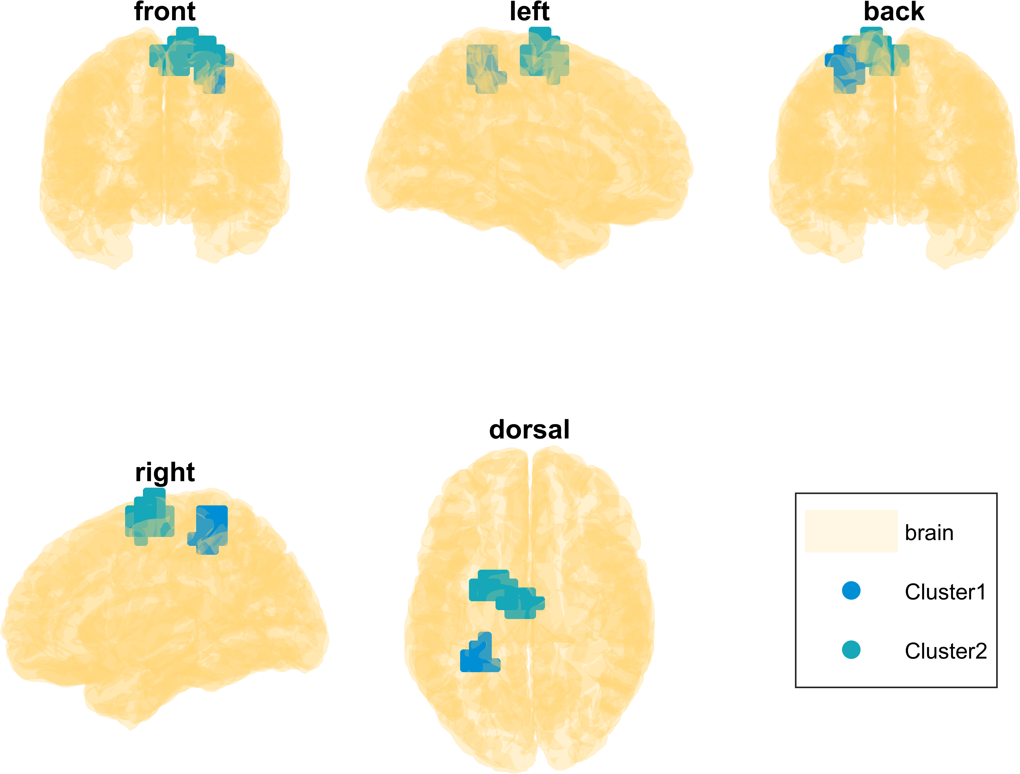
DBSCAN- beta, const/rand1, until_500 (neg)
27/10/22:Updated results with epsilon = 1.5*gridsize
Nothing changed here
Cluster 1 (neg):
018: Postcentral_L
011: Parietal_Sup_L
002: Parietal_Inf_L
Cluster 2 (neg):
026: Frontal_Sup_L
019: Supp_Motor_Area_L
016: Paracentral_Lobule_L
004: Precentral_L
002: Supp_Motor_Area_R
Negative cluster:
Rand1 > const

Slide 30
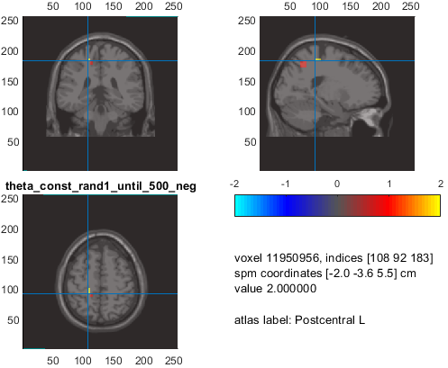
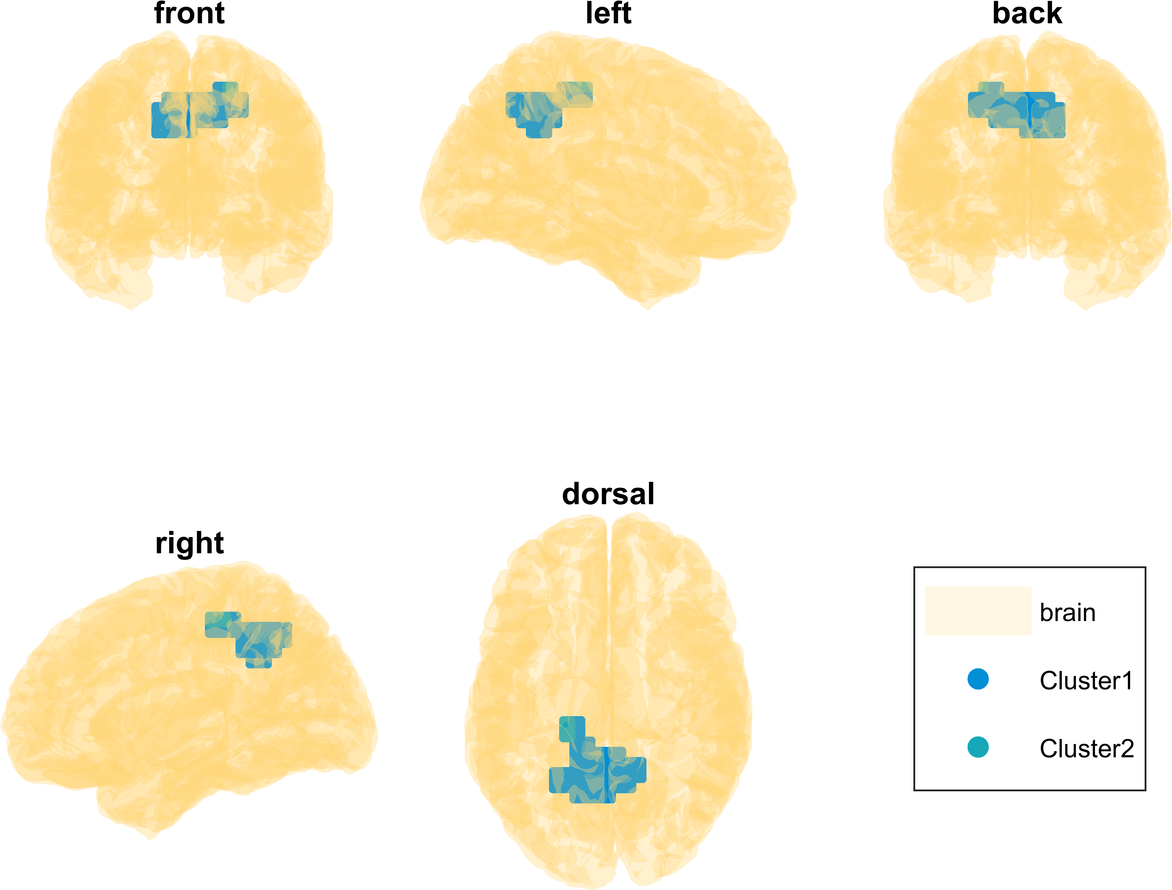
DBSCAN- theta, const/rand1, until_500 (neg)
27/10/22:Updated results with epsilon = 1.5*gridsize
Both clusters changed
Cluster 1 (neg):
047: Precuneus_L
027: Precuneus_R
010: Parietal_Sup_L
007: Cingulum_Mid_L
002: Postcentral_L
001: Cingulum_Mid_R
Cluster 2 (neg):
002: Parietal_Inf_R
001: Angular_R
Negative cluster:
Rand1 > const

Slide 31
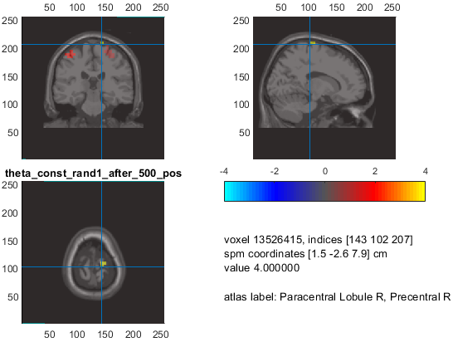
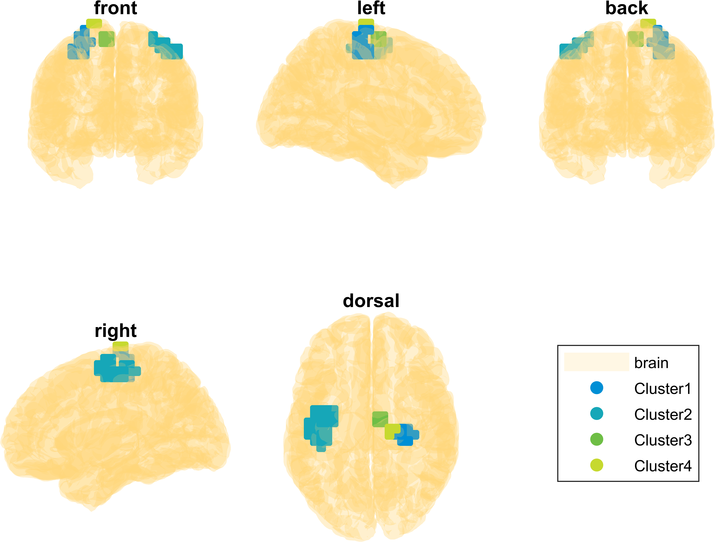
DBSCAN- theta, const/rand1, after_500 (pos)
27/10/22:Updated results with epsilon = 1.5*gridsize
4th cluster gone, cluster 1 changed
Cluster 1 (pos):
021: Precentral_R
004: Postcentral_R
Cluster 2 (pos):
026: Precentral_L
015: Postcentral_L
003: Frontal_Sup_L
Cluster 3 (pos):
007: Supp_Motor_Area_R
Positive cluster:
Const > rand1

Slide 32
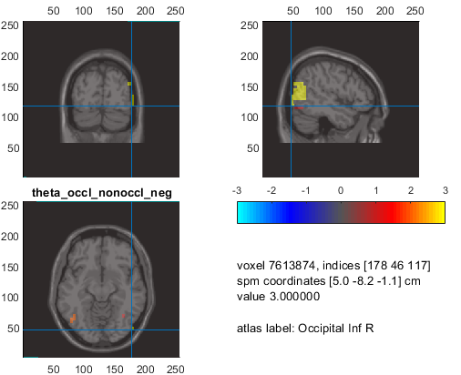
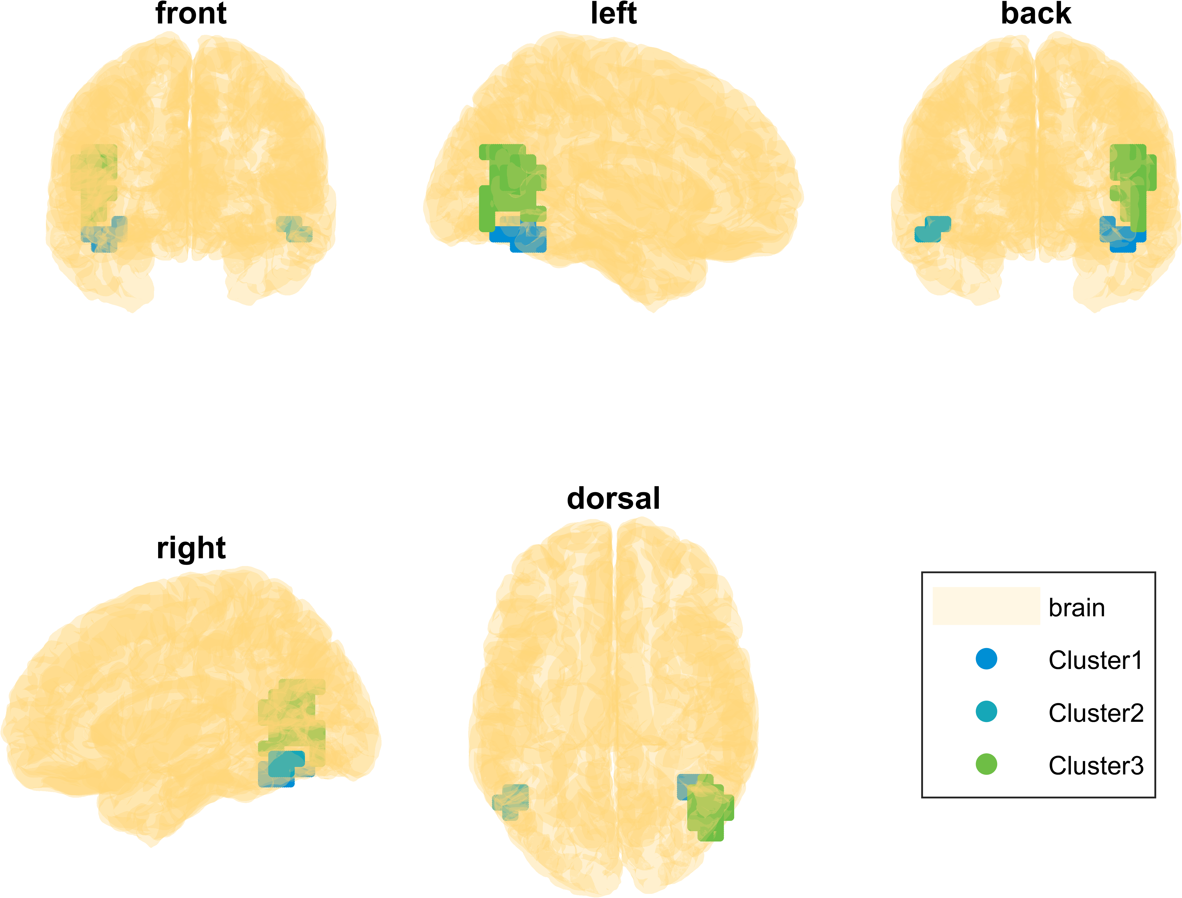
DBSCAN- theta, occl/visible (negative cluster)
27/10/22:Updated results with epsilon = 1.5*gridsize
Nothing changed here
Cluster 1 (neg):
010: Fusiform_R
006: Occipital_Inf_R
Cluster 2 (neg):
004: Occipital_Inf_L
003: Temporal_Inf_L
Cluster 3 (neg):
048: Temporal_Mid_R
012: Occipital_Mid_R
002: Occipital_Inf_R
001: Angular_R
Negative cluster → visible > occluded

Slide 33
Segmentation overview
To be found in: R:\AG-Beste-Studien\Emulation\10_publications\02_action_monitoring\figures\segmentation

Slide 34
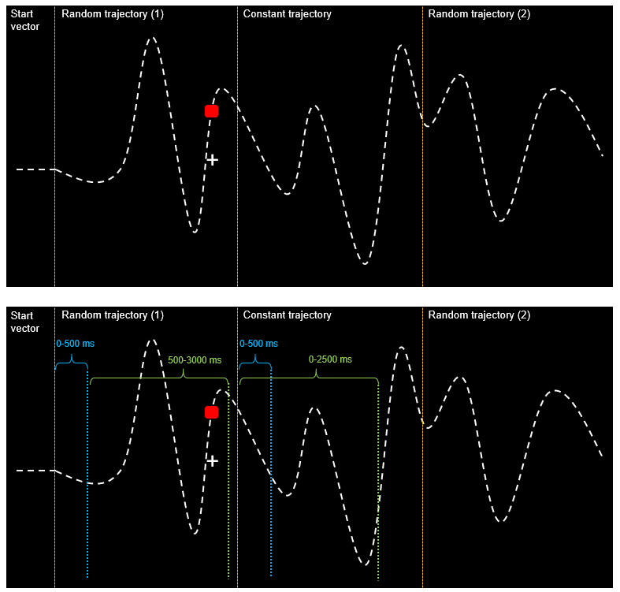

Slide 35
